Slide 1
Chapter 10
Understanding Generics

Slide 2
Objectives
The need of Generics
Discovering the System.Collections.Generic namespace
How to create Generic methods and Generic structures

Slide 3
Content
The problem with (Un)Boxing operations
The System.Collections.Generic namespace
Creating Generic methods
Creating Generic structures
Creating a custom Generic collection
Creating Generic base classes
Creating Generic interface
Creating Generic delegates

Slide 4
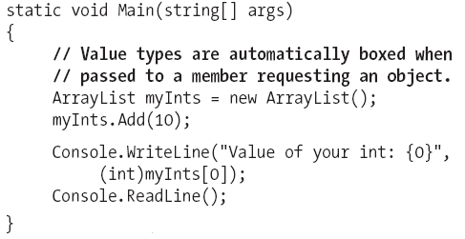
1. The problem with (Un)Boxing operations
Transfer memory between stack/heap comes with the baggage of performance issues and a lack of type safety.
Example
Notes:
Baggage: hành lý

Slide 5
2. The System.Collections.Generic namespace
Contains numerous class and interface types that allow to contain subitems in a variety of containers.

Slide 6
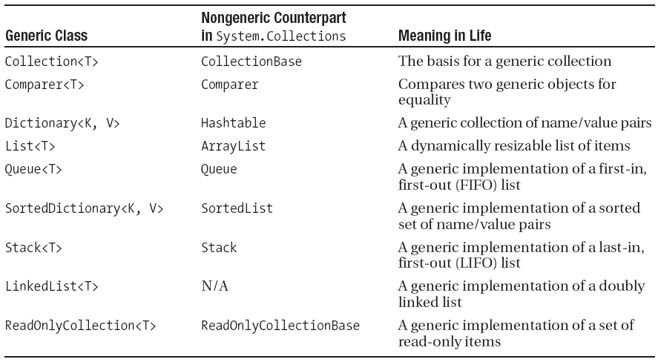
Classes of System.Collections.Generic

Slide 7
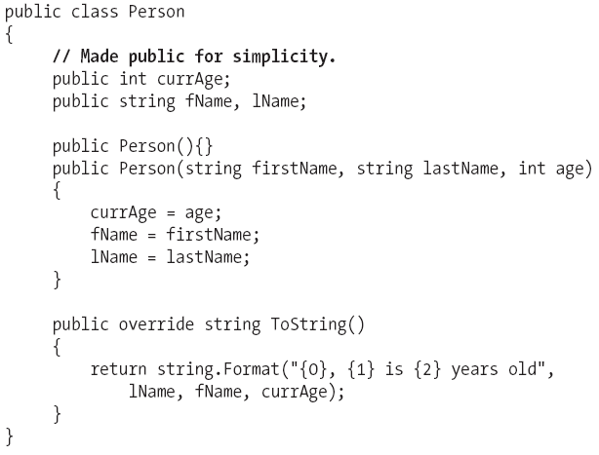
Examining the List<T> type

Slide 8
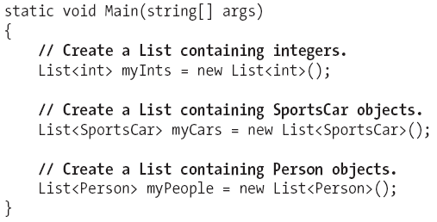
Examining the List<T> type (cont.)

Slide 9
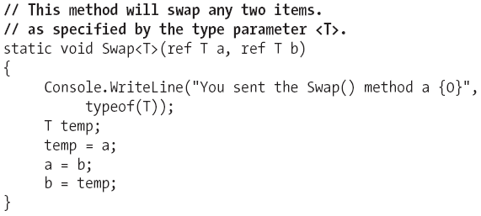
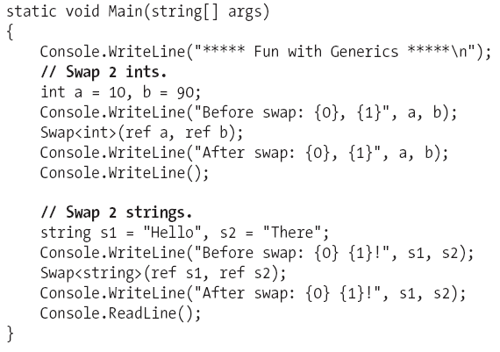
3. Creating Generic methods
Example of a generic swap routine

Slide 10
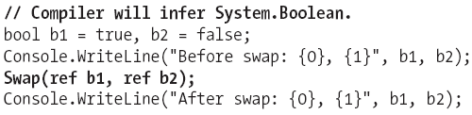
3. Creating Generic methods
Can omit the type parameter if (and only if) the generic method requires arguments

Slide 11
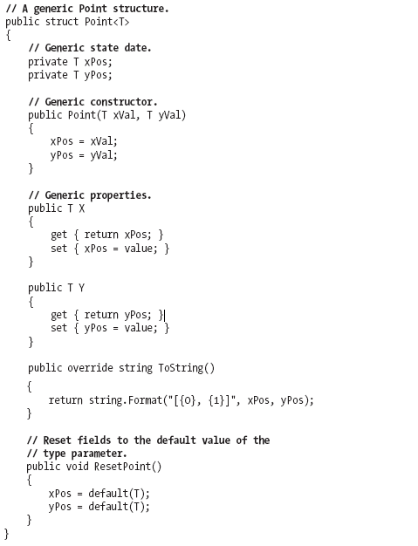

4. Creating Generic structures

Slide 12
5. Creating a custom Generic collection
Home reading

Slide 13
6. Creating Generic base classes
Home reading

Slide 14
7. Creating Generic interfaces
Home reading

Slide 15
8. Creating Generic delegates
Home reading

Slide 16
Summary
A Generic item allows to specify “placeholders” (type parameters) that are specified at the time of invoking the generic method or creating the generic type.
Beside of using the built-in generic types, can create custom generic types

Slide 17
Q & A

